Slide 1


Forest Fire Detection Using
Deep learning
Student Name: Vadla Yogeshwar
AICTE Student ID: STU6596b38a25dfe1704375178
AICTE Internship ID: INTERNSHIP_174099535967c57b1f336c3

Slide 2

Learning Objectives
Learning Objectives for Forest Fire Detection using DL:
Understand and Apply CNN Architectures for Binary Image Classification
Learn how Convolutional Neural Networks (CNNs) can be used to classify images into two categories: fire and nofire.
Gain practical experience in building CNN models using TensorFlow and Keras.
Perform Image Preprocessing and Augmentation
Understand the importance of rescaling and reshaping images before feeding them into neural networks.
Learn to use ImageDataGenerator for data preprocessing and augmentation to improve generalization.
Utilize Transferable Machine Learning Tools and Libraries
Gain experience working with powerful Python libraries such as TensorFlow, Matplotlib, NumPy, and Streamlit.
Explore how to efficiently handle image datasets using flow_from_directory.
Visualize and Interpret Model Performance
Plot and analyze training vs validation accuracy and loss to detect underfitting or overfitting.
Learn to evaluate model performance using test datasets and interpret metrics such as accuracy and loss.
Build Real-Time Fire Detection System using Streamlit
Learn how to convert a trained CNN model into a functional web app using Streamlit.
Develop user-friendly interfaces for real-time wildfire prediction from uploaded images.
Deploy Deep Learning Models for Real-World Applications
Understand the end-to-end workflow of downloading a dataset, training a model, evaluating its performance, and deploying it for real-time use cases.
Learn how to save, load, and reuse models using the .keras format.
Explore the Role of AI in Disaster Management
Understand the potential impact of AI-based systems in early detection and mitigation of forest fires.
Reflect on how computer vision contributes to environmental monitoring and safety.
GOAL
Source :
www.freepik.com/

Slide 3
Tools and Technology used
Programming Language
Python: Used for implementing the entire workflow, including data handling, model building, training, and deployment.
Libraries & Frameworks
TensorFlow / Keras: Used for building and training the Convolutional Neural Network (CNN) model.
Modules used:
Sequential, Conv2D, MaxPooling2D, Dense, Dropout, etc.
ImageDataGenerator for preprocessing images.
model.save() and load_model() for saving/loading trained models.
NumPy: Used for numerical operations and array manipulations, especially for image data preprocessing.
Matplotlib: Used for visualizing sample images, training/validation accuracy, and loss graphs.
OS: Used to navigate and manage directories and image paths in the dataset.
KaggleHub: Used to download datasets directly from Kaggle programmatically.
Pillow (PIL): Used to handle and preprocess uploaded images in the Streamlit app.
Streamlit:
Used to build an interactive web app for real-time wildfire image detection.
Enables uploading images and displaying predictions in a browser.

Slide 4
Platform: Google Colab
Cloud-based Jupyter Notebook environment by Google.
Provides free access to GPUs for faster model training.
Supports Python and integrates seamlessly with TensorFlow, Matplotlib, and other ML libraries.
Used for the full implementation, training, and evaluation of the wildfire detection model.
Dataset:
The Wildfire Dataset (elmadafri/the-wildfire-dataset) Sourced from Kaggle.
Contains images categorized as fire and nofire.
Split into training, validation, and test sets.
Development Environment
Google Colab: Used as the primary development environment for writing, training, and evaluating the deep learning model. Colab provides free GPU support, which was utilized to accelerate training using TensorFlow.
Streamlit: Used for deploying the trained model as a web application. The Streamlit app allows users to upload images and receive real-time predictions, making the system interactive and easy to use.

Slide 5
Methodology
The following methodology was followed for developing a forest fire detection system using Convolutional Neural Networks (CNN) in Google Colab:
1. Dataset Acquisition
The wildfire dataset was programmatically downloaded from Kaggle using the kagglehub library.
The dataset contains labeled images categorized into two classes: fire and nofire.
The dataset was structured into separate folders for training, validation, and testing.
2. Exploratory Data Analysis (EDA)
The structure and contents of the dataset were examined using the os library.
Sample images from both classes were visualized using matplotlib to gain insights into image quality, resolution, and diversity.
3. Data Preprocessing
All images were resized to 150x150 pixels to ensure uniform input size for the CNN.
Pixel values were normalized to the range [0, 1] using ImageDataGenerator with rescaling.
Image batches were loaded from directories using flow_from_directory for efficient memory usage and preprocessing.
4. Model Development
A Sequential CNN architecture was built using TensorFlow and Keras.The model included: Three convolutional layers with ReLU activation and max pooling.
A flatten layer to convert feature maps into a 1D vector.
A dense layer with 512 neurons and ReLU activation.
A dropout layer to reduce overfitting.
A final dense layer with a sigmoid activation function for binary classification.

Slide 6
5. Model Compilation and Training
The model was compiled using the Adam optimizer, binary crossentropy loss function, and accuracy as the evaluation metric.
The model was trained for 12 epochs using the training set and validated on the validation set after each epoch.
6. Model Evaluation (Confusion Matrix)
Training and validation accuracy/loss curves were plotted to evaluate the model's performance and detect overfitting or underfitting.
After training, the model was evaluated on the test dataset.
A confusion matrix was generated to visualize true vs. predicted labels.
The model was evaluated on the test set to assess its generalization capability using unseen data.
7. Model Saving
The trained model was saved in .keras format (FFD.keras) for later use and deployment.
8. Deployment using Streamlit
A Streamlit web application was developed to provide a user-friendly interface for real-time wildfire detection.
The app allows users to:
1.Upload an image.
2.Predict whether the image contains a fire or not.
3.View the prediction result and the uploaded image.
9. Testing the Web Application
The Streamlit app was tested with various sample images to verify its functionality.
Model predictions were compared with the known labels to ensure accuracy and reliability.

Slide 7
Problem Statement:
Forest fires pose a serious threat to the environment, biodiversity, and human life. Rapid detection of such fires is essential for initiating timely intervention and minimizing damage. Traditional detection systems often rely on satellite data or manual observation, which can be delayed or ineffective due to weather conditions, smoke coverage, or limited monitoring capacity.
To address these challenges, there is a need for an intelligent, automated system that can accurately detect forest fires using visual data. This project proposes the development of a deep learning-based image classification system that can analyze visual inputs and classify them into two categories: 'fire' and 'nofire'. By leveraging the power of Convolutional Neural Networks (CNNs), the system aims to provide high accuracy in fire detection, enabling faster decision-making and contributing to effective disaster prevention and environmental protection.

Slide 8
Solution:
To address the problem of delayed and inefficient forest fire detection, this project proposes a deep learning-based image classification system that automatically identifies the presence of fire in images. The solution leverages the power of Convolutional Neural Networks (CNNs) to distinguish between images containing fire and those without.
GitHub link : Click Here -> Wildfire Detection https://github.com/Yogeshwarypl/Week1/blob/main/wildfire_app.py
Source Code: Click Here! https://github.com/Yogeshwarypl/Week1/blob/main/Forest_Fire_Detection_using_DL.ipynb
Key Steps in the Solution:
1. Dataset Collection and Preparation
A publicly available dataset of wildfire images was used, consisting of two categories: fire and nofire.
The dataset was divided into training, validation, and testing sets.
All images were resized to a uniform size (150x150 pixels), and pixel values were normalized to enhance training efficiency.
2. Model Development using CNN
A deep learning model was built using TensorFlow and Keras.
The CNN architecture includes:
Multiple convolutional layers to extract spatial features from images.
MaxPooling layers to reduce dimensionality and computation.
A dense layer with dropout to prevent overfitting.
A final sigmoid activation layer for binary classification.
3. Model Training
The model was trained using the processed dataset over multiple epochs with real-time validation.
The model was compiled using Adam optimizer and binary cross-entropy loss.
It was trained over 12 epochs, with training and validation accuracy and loss plotted for evaluation.

Slide 9
4. Model Evaluation Using Confusion Matrix
After training, the model was evaluated on the test dataset.
A confusion matrix was generated to analyze the number of correct and incorrect predictions for each class.
A classification report was generated to evaluate precision, recall, F1-score, and support for each class.
The model was evaluated on unseen test data to measure generalization accuracy.
5. Model Saving and Deployment
The trained model was saved in .keras format for later use.
A user-friendly web application was created using Streamlit.
Users can upload an image.
The model processes the image and outputs whether it contains fire or not.
The result is displayed along with the input image for verification.
GitHub link : Click Here -> Wildfire Detection
https://github.com/Yogeshwarypl/Week1/blob/main/wildfire_app.py
Complete Project Source Code: Click Here!
6. Real-Time Prediction
The deployed model provides fast and accurate predictions for uploaded images.
This supports early detection of forest fires and can be integrated into larger monitoring systems.

Slide 10
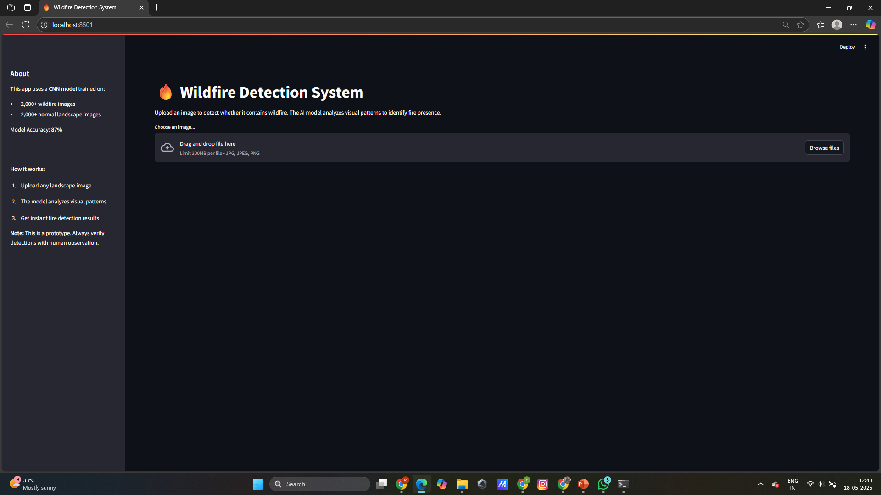
Screenshot of Output:
Fig. Deployment of Wildfire Detection System (Forest Fire Detection System)

Slide 11
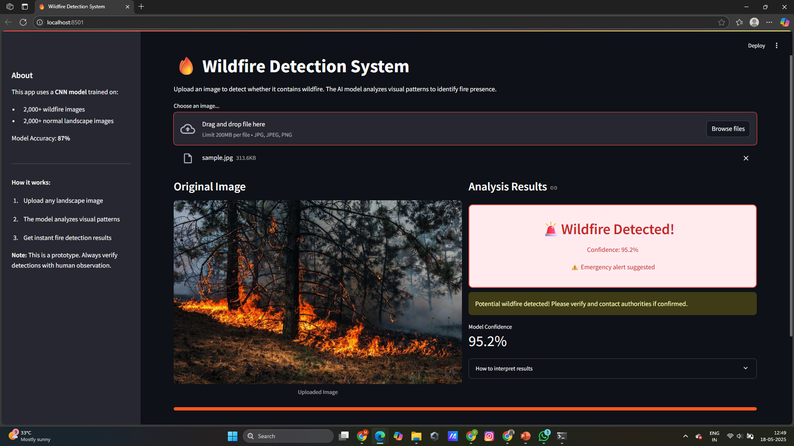
Fig. Wildfire Detection System Prediction

Slide 12
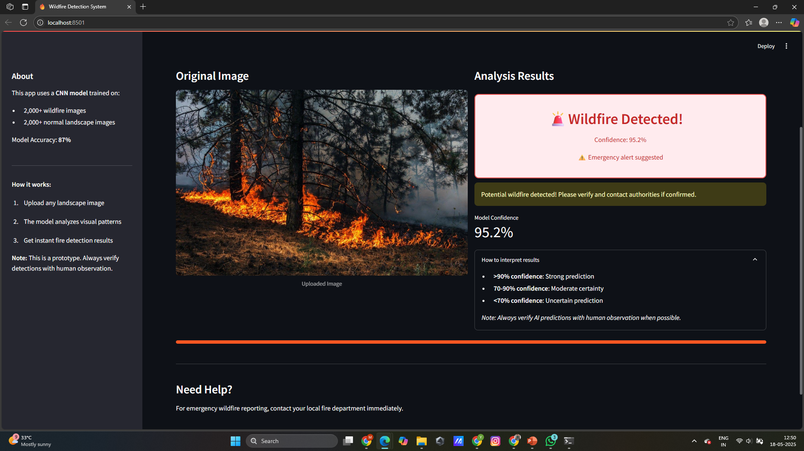
Fig. Wildfire Detection System Prediction Results

Slide 13
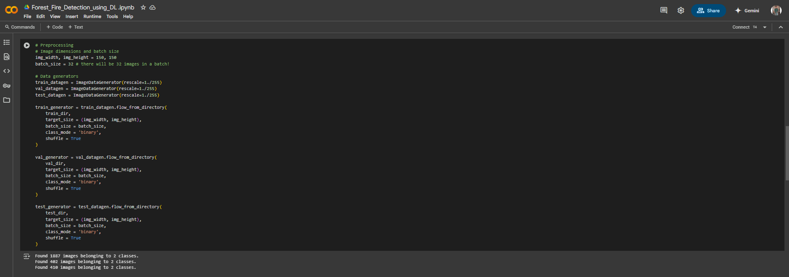
Fig. Wildfire Detection System Data Preprocessing

Slide 14
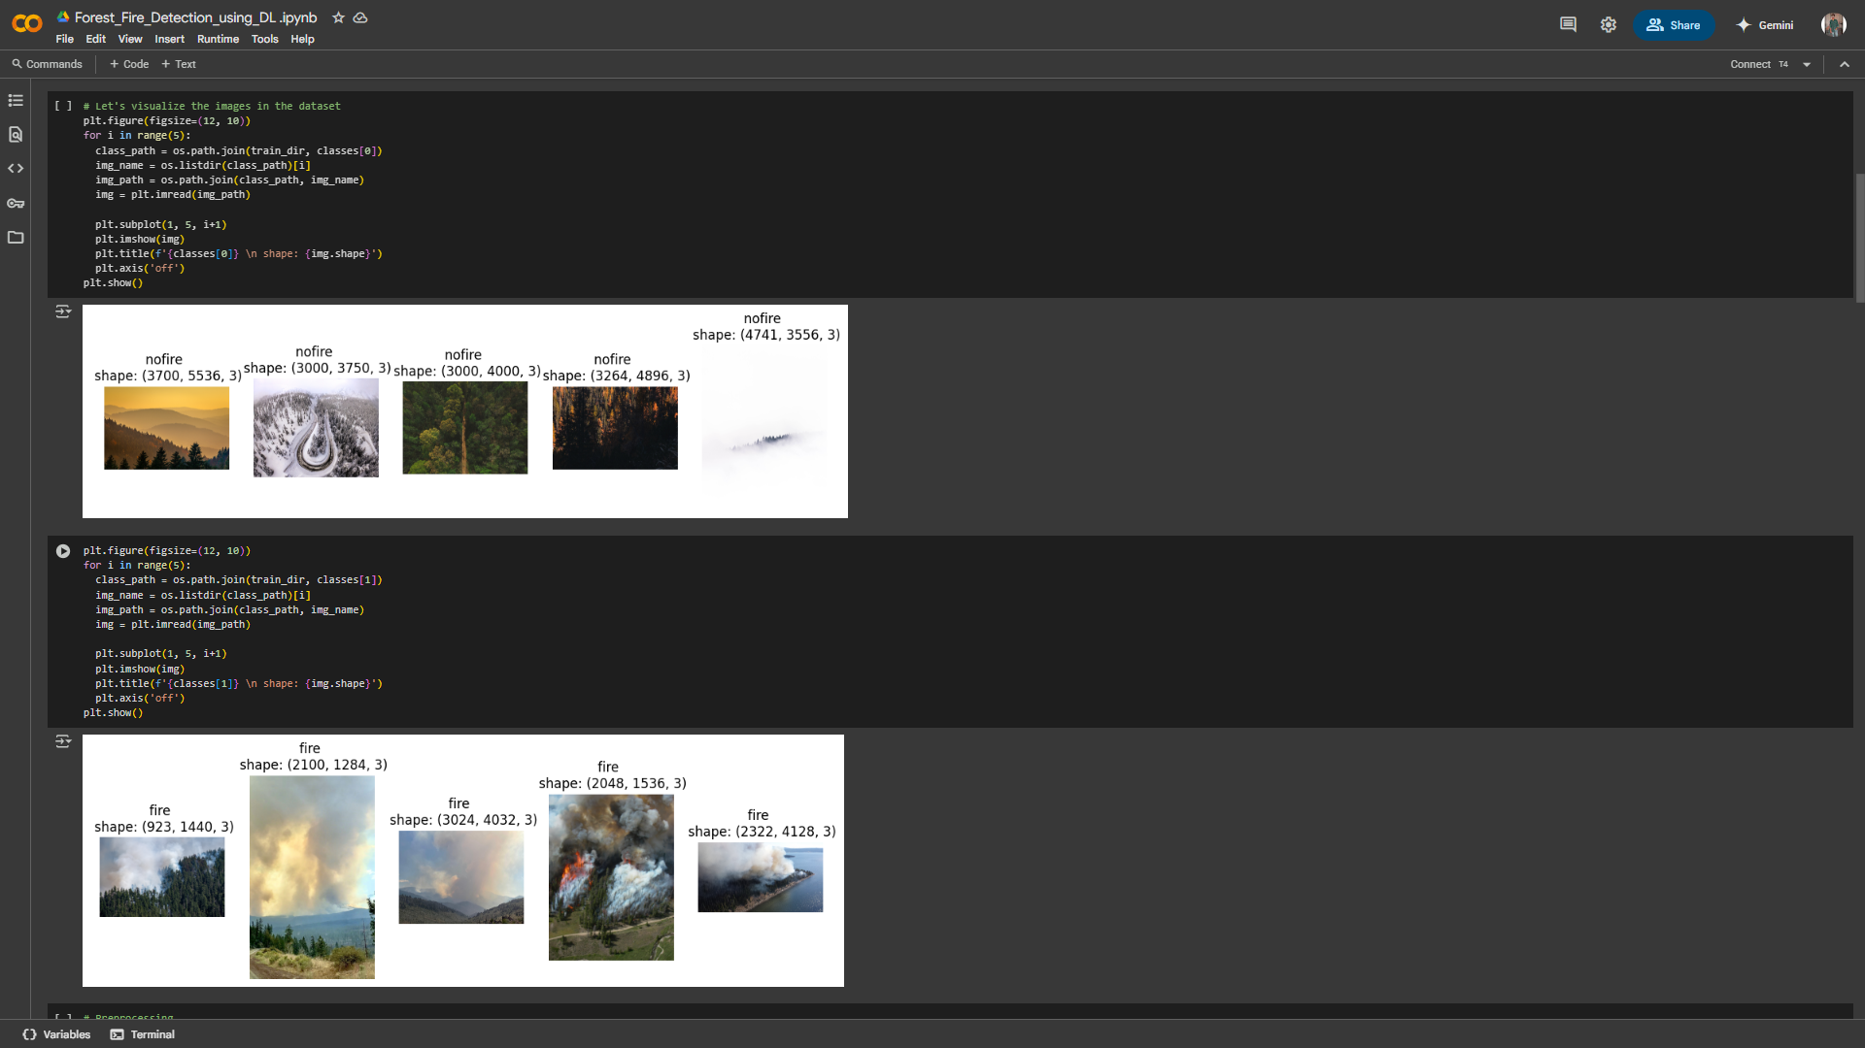
Fig. Data Visualization of Binary classes (Fire, Nofire)

Slide 15
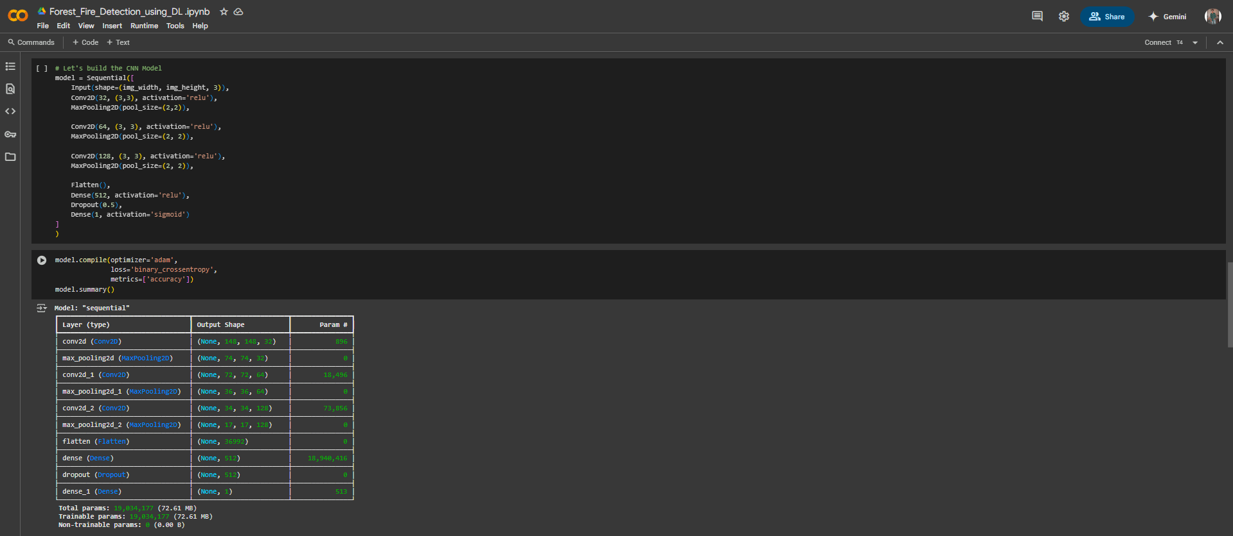
Fig. CNN Model Architecture and Model Summary (CNN Layers)

Slide 16
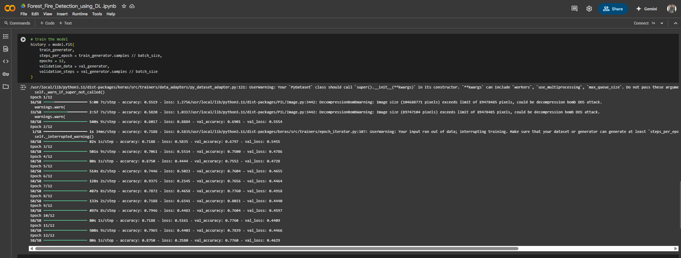
Fig. Training the Wildfire Detection Model

Slide 17
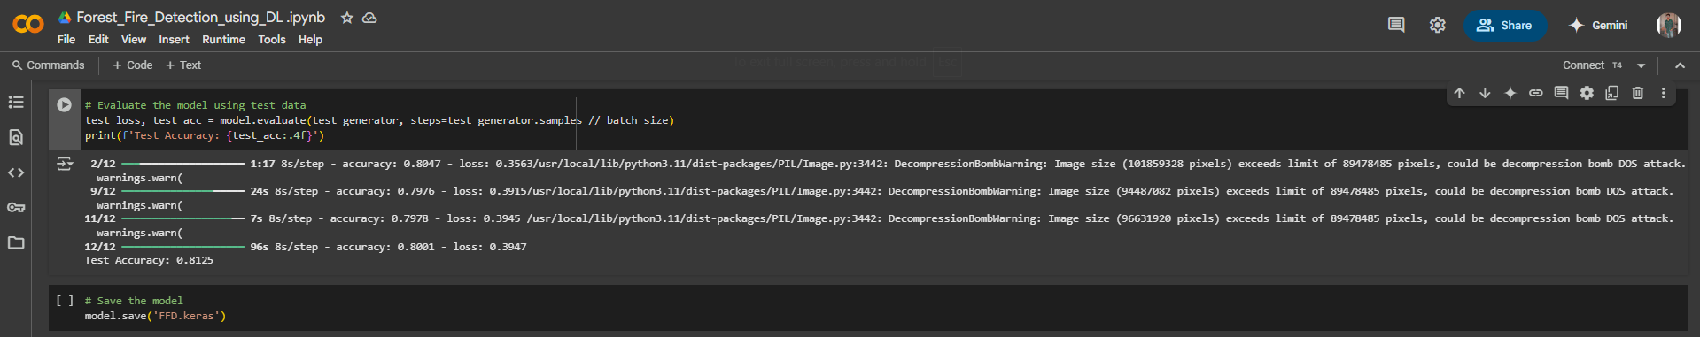
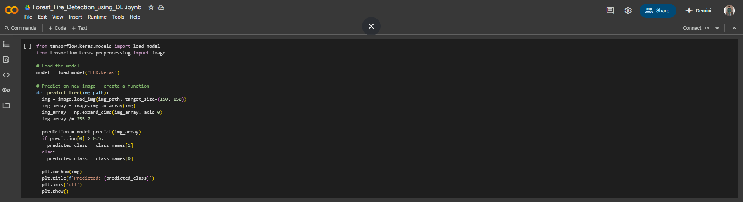
Fig. Evaluating the Model (Testing)
Fig. Wildfire Detection Model Prediction

Slide 18
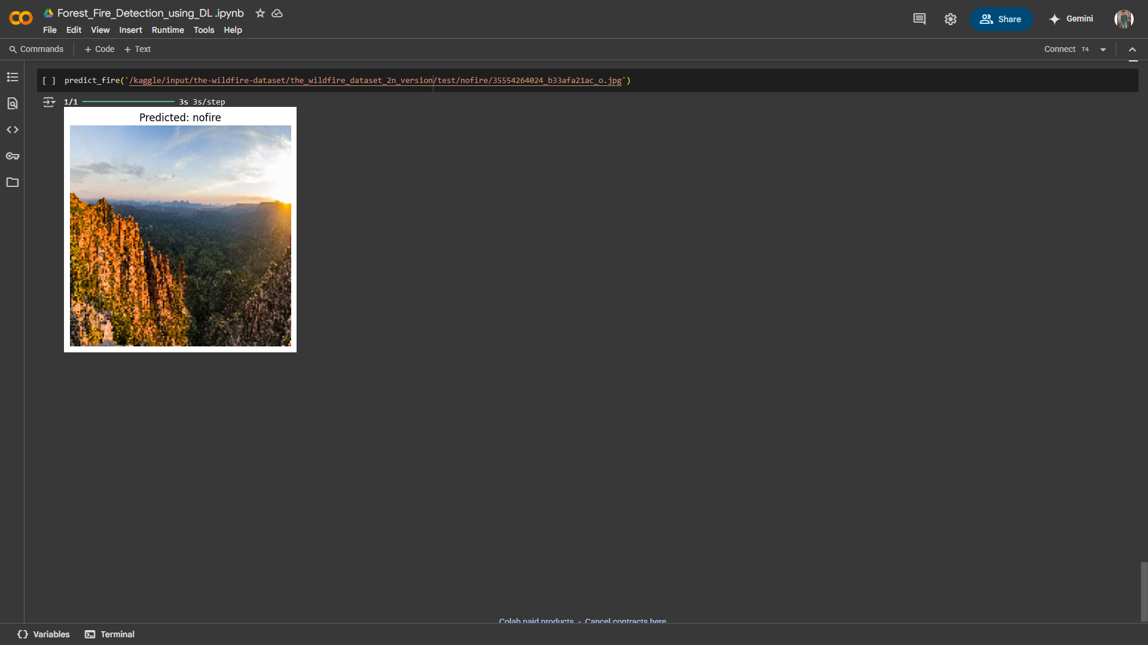
Fig. Wildfire Detection Model Prediction Results

Slide 19
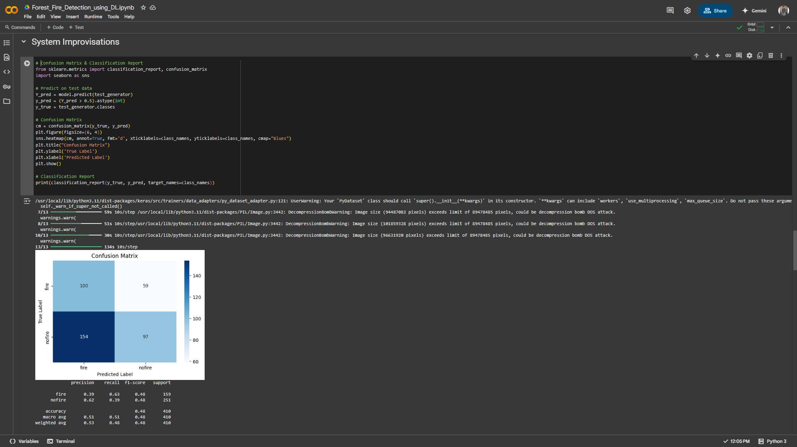
Model Evaluation Metrics
Fig. Confusion Matrix

Slide 20
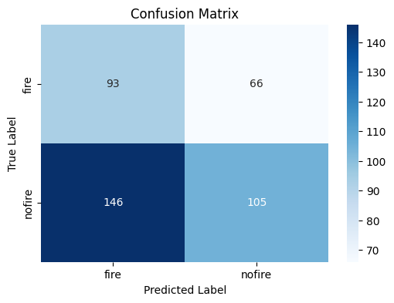
Evaluate the model – Confusion Matrix

Slide 21
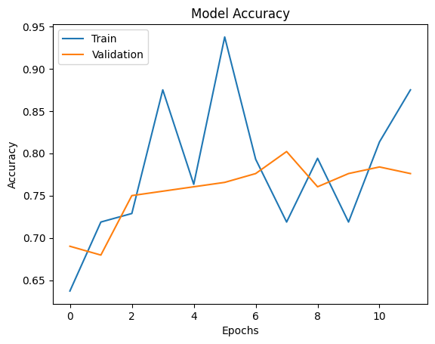
Fig. Evaluate the model - training and validation accuracy

Slide 22
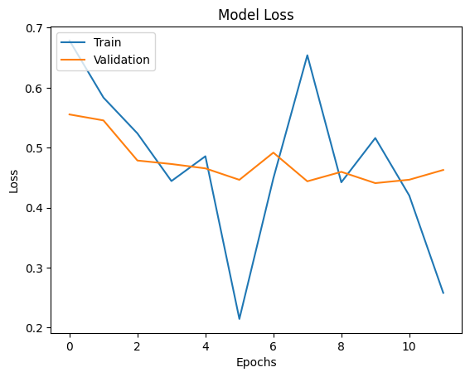
Fig. Evaluate the model - training and validation loss

Slide 23
Conclusion:
This project successfully demonstrates the application of deep learning techniques for detecting forest fires through image classification. By leveraging Convolutional Neural Networks (CNNs), the system was able to accurately classify images into 'fire' and 'nofire' categories. The model was trained, evaluated, and deployed effectively using tools such as TensorFlow, Keras, and Streamlit.
The results indicate that the proposed system can serve as a reliable early warning tool, supporting quicker response to potential wildfire outbreaks. With its ability to analyze visual data in real time, the system has the potential to be integrated into broader environmental monitoring frameworks, thereby contributing to improved disaster management and prevention strategies.
This project highlights how artificial intelligence can play a crucial role in addressing real-world environmental challenges through automation and intelligent decision-making.

Slide 24
Future Scope
The current implementation demonstrates the effectiveness of Convolutional Neural Networks in detecting forest fires from images. However, there are several avenues for extending and enhancing this system in the future:
1. Integration with Real-Time Surveillance Systems
The model can be integrated with live CCTV or drone footage for continuous real-time forest monitoring.
This would allow for automated alerts and early warning systems based on video stream analysis.
2. Geospatial and Temporal Analysis
Combine image classification with geospatial data (e.g., GPS coordinates, weather patterns) to assess fire spread potential.
Use time-series data to track changes and improve decision-making during fire incidents.
3. Multiclass Classification
Expand the system to detect various fire stages, such as smoke detection, small flame, and large blaze, instead of just binary classification.
Add classes like “smoke,” “fire-start,” “controlled fire,” etc., for more fine-grained detection.
4. Edge Deployment
Optimize the model for deployment on low-power edge devices, such as Raspberry Pi or NVIDIA Jetson, for in-field fire monitoring in remote forest areas.
5. Mobile or Web Application Integration
Develop a user-friendly mobile app or web interface using Streamlit, where users can upload images and get predictions instantly.
Authorities can use the interface to monitor fire alerts on a dashboard.
6. Improved Model Accuracy
Use advanced architectures like ResNet, EfficientNet, or MobileNet to improve accuracy and inference speed.
Implement data augmentation and transfer learning to reduce overfitting and enhance model generalization.
7. Alert and Notification System
Integrate automated email/SMS alerts when a fire is detected.
Add timestamped logs for tracking predictions and model decisions.

